Slide 1
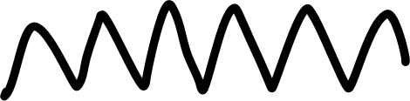











Six Thinking Hats

Slide 2
THE BOOK
‘The six thinking hats’ is a book by edward de bono. Where he has mentioned six thinking hats depicting six different thinking strategies which are needed to be looked upon while launching a design, idea or even a presentation.

Slide 3
The Hats
White – Facts and figures
Red – emotions
Black – caution
Yellow – optimism
Green – new ideas
Blue – goal setting summarizing

Slide 4

THE BLACK HAT

Slide 5
THE BLACK HAT
‘The black hat represents caution and what could go wrong. It points out what doesn’t fit, what may not work, what is wrong, and hence protects us from fatal flaws and wasted resources. The black hat recognizes the value of caution and risk assessment; it makes our plans more robust.

Slide 6
Very easy to explain yet extremely needed before implementing an idea

Slide 7
It talks about….!!!

Slide 8
CHANGE
IMPORVEMENT
STRONGER TEAMWORK
AND CONSTRUCTIVE CRITICISM

Slide 9
BY FOCUSING ON

Slide 10
PITFALLS
CHALLENGES
MISTAKES
DANGER
MISFITS

Slide 11
USAGE EXAMPLES

Slide 12

FAIR AND LOVELY
GLOW AND LOVLEY
It was a response by the brand to growing concerns and criticism regarding the promotion of fairness and the use of skin-lightening terminology in beauty products.

Slide 13

Bisleri
And if Bisleri must haven't thought upon the variation of sizes in their bottle to serve different purposes they might not have been a popular packaged drinking water brand.

Slide 14
Conclusion
Black hat thinking can be abused and overused if it is the only mode of thinking. This abuse is no way diminished the value of black hat, just as the dangerous and reckless driving of a car does not mean that cars are dangerous.

Slide 15
Thank you!

